Slide 1
Master Discussion
14.05.2018
Malvik & Witzøe

Slide 2
Contents
New Recourse Model
New Scenario Generation Model

Slide 3
New Recourse Model
As noted by Bjarne, changes are implemented step-wise
The system is allowed to reach a «steady-state» after implementing each change
This is akin to «observing» the scenario for the well we change, i.e. actual gas and oil rates
If a change leads to infeasibility it is rolled back, but we now have information on the true behavior for the well we changed

Slide 4
Recourse Algorithm
Assume scenario generation using variance constants. Assume robust optimization with a set S of scenarios.
The following strategy is used:
Choose current solution = starting scenario where x/7 wells are producing with known scenario constants stored in the set K.
Choose n = initial maximum changes available
Then, while n>0, do:
Optimize robust model with S scenarios, maximum n changes from current solution and known constants K
Choose one well w to implement suggested change on by ordering wells greedily by Gas-Oil-Ratio, but prioritize negative choke changes first
Draw a scenario constant A_{w} for well we wish to change (note: not drawn from S)
If new choke setting for w under A_{w} is feasible:
Current solution ← new solution
Else:
Current solution unchanged
K = K ∪ {A_{w}}
n = n-1

Slide 5
Recourse Algorithm
As we implement changes, we learn the true scenario constants for the changed wells
For each run, we record the objective values attained and if infeasibility occured during any of the steps
For different robust optimization scenario set sizes and the EEV approach, the algorithm was repeated 200 times

Slide 6
Recourse Algorithm - Results
Initial scenario: Wells 1 and 3 shut off, rest producing
EEV produces 10/200 = 5% infeasible solutions, but reaches a higher average objective value
For > 15 scenarios, we never reach infeasibility. Objective value stabilizes

Slide 7
Recourse Algorithm – Discussion Points
For wells that are already producing, we assume we know the entire scenario distribution. In reality, we only know what our scenario looks like for the current choke setting
For the presented initial scenario, we avoided infeasibility with fairly few scenarios in the robust optimization. May need to explore different scenarios to see if this holds more generally

Slide 8
New Scenario Generation Model
We desire the following properties in a scenario generation procedure:
The scenario curve should be able to intersect a given (choke, output) point if specified, since we know our current production rate for wells that are already producing (but are uncertain about other regions of the curve)
The scenario curve should be able to vary around the mean more freely than the constant variance term drawing procedure

Slide 9
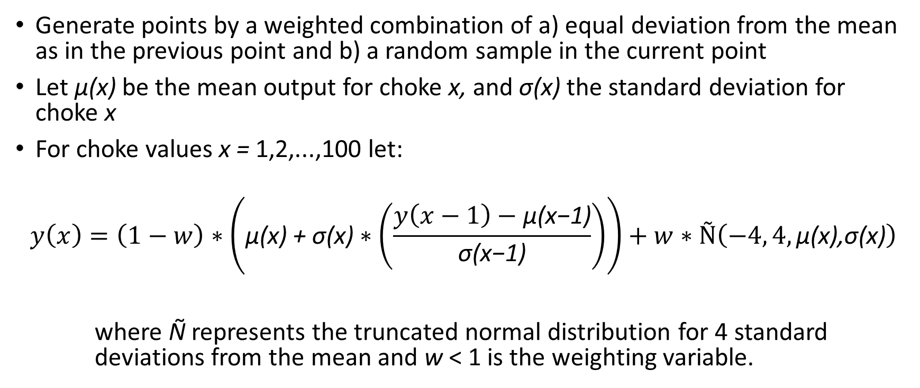
New Scenario Generation Model
Generate points by a weighted combination of a) equal deviation from the mean as in the previous point and b) a random sample in the current point
Let μ(x) be the mean output for choke x, and σ(x) the standard deviation for choke x
For choke values x = 1,2,...,100 let:
$$y\left(x\right)=\left(1−w\right)∗\left(\text{μ}\text{(}\text{x}\text{) + }\text{σ}\text{(}\text{x}\text{)}∗\left(\frac{y\left(x−1\right)−\text{μ}\text{(}\text{x}\text{−1}\text{)}}{\text{σ}\text{(}\text{x}\text{−1}\text{)}}\right)\right)+w∗Ñ\left(−4, 4,\text{μ}\text{(}\text{x}\text{),}\text{σ}\text{(}\text{x}\text{)}\right)$$
where Ñ represents the truncated normal distribution for 4 standard deviations from the mean and w < 1 is the weighting variable.

Slide 10
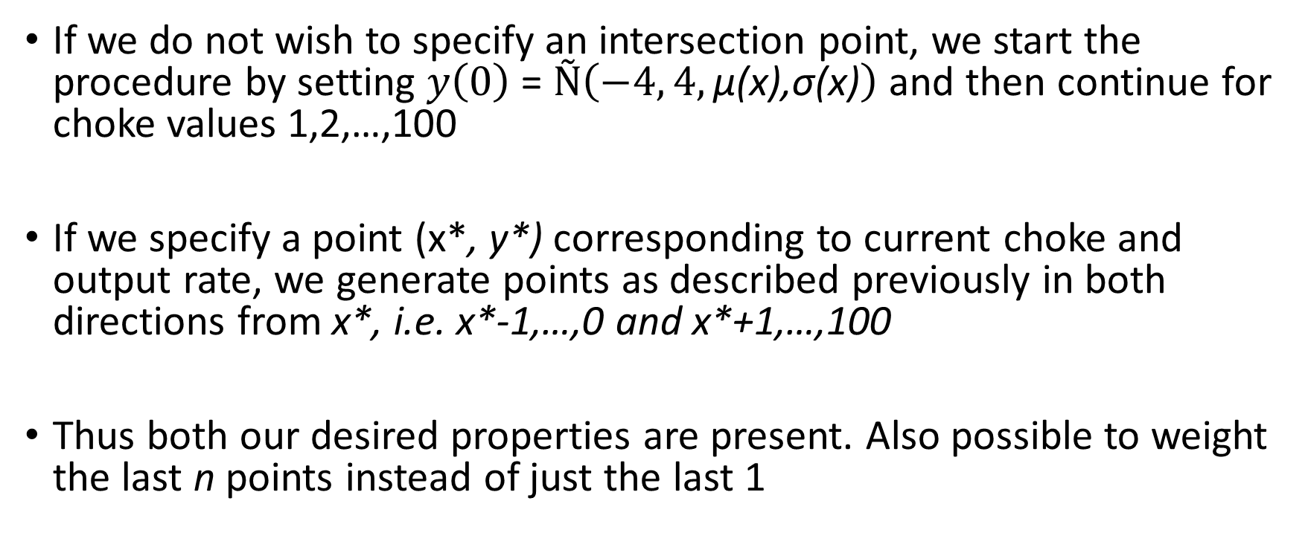
New Scenario Generation Model
If we do not wish to specify an intersection point, we start the procedure by setting $y\left(0\right)$ = $Ñ\left(−4, 4,\text{μ}\text{(}\text{x}\text{),}\text{σ}\text{(}\text{x}\text{)}\right)$ and then continue for choke values 1,2,…,100
If we specify a point (x*, y*) corresponding to current choke and output rate, we generate points as described previously in both directions from x*, i.e. x*-1,…,0 and x*+1,…,100
Thus both our desired properties are present. Also possible to weight the last n points instead of just the last 1

Slide 11
Scenario Generation Model - Results
Tunable parameters: Weighting and sampling density along x-axis
Green dashed line represents generated scenario
Black solid line represents the mean
Each shade of blue corresponds to 1 standard deviation
Note: Choke values on x-axis are incorrect, should be interpreted as 0-100

Slide 12
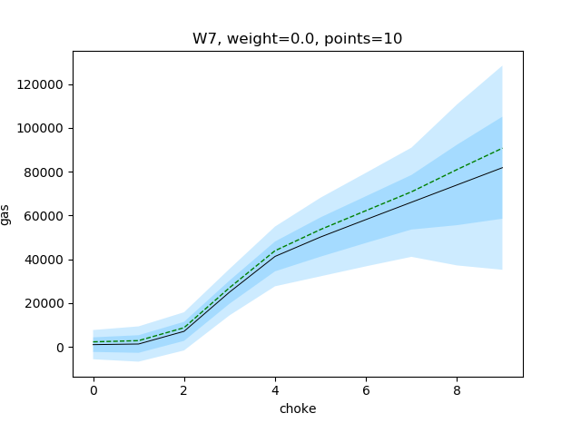
Varying the Weight Parameter – w = 0.0

Slide 13

Varying the Weight Parameter – w = 0.3

Slide 14
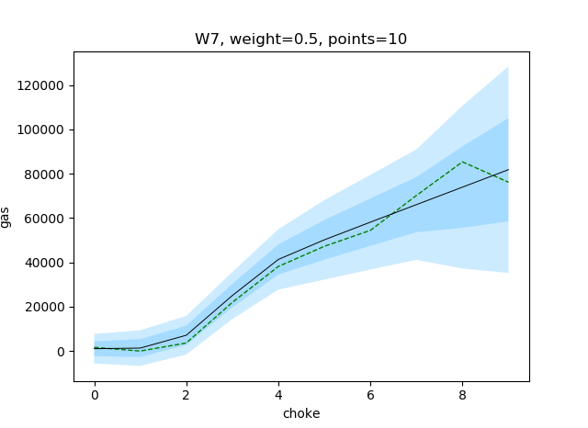
Varying the Weight Parameter – w = 0.5

Slide 15
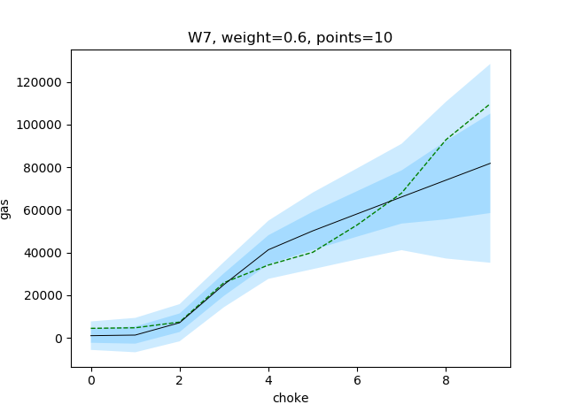
Varying the Weight Parameter – w = 0.6

Slide 16

Varying the Weight Parameter – w = 1.0

Slide 17
Varying the Weight Parameter
Increasing the weight of the random draw yields more erratic curves
For w = 0.0, the shift from the mean is constant along the entire curve

Slide 18
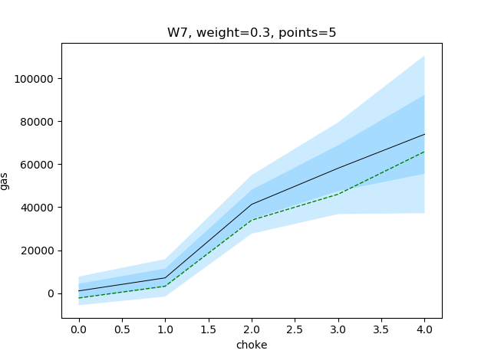
Varying the Amount of Points – points = 5

Slide 19

Varying the Amount of Points – points = 10

Slide 20
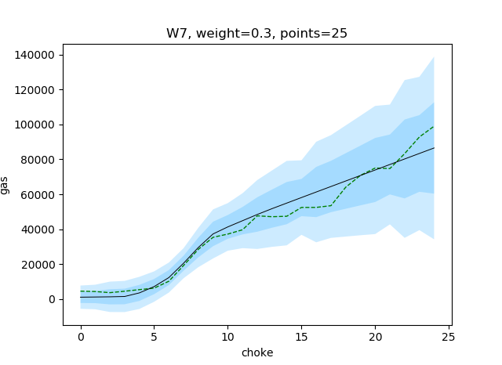
Varying the Amount of Points – points = 25

Slide 21
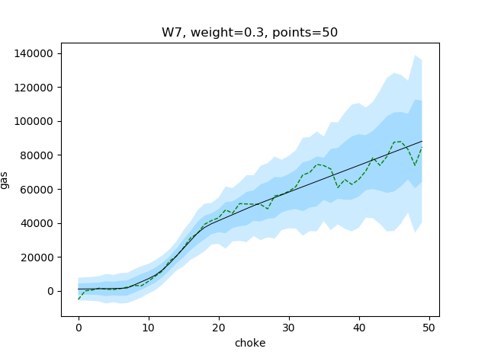
Varying the Amount of Points – points = 50

Slide 22
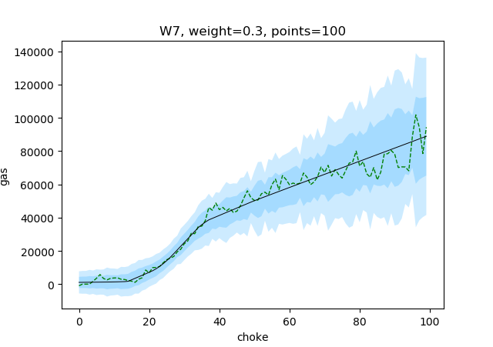
Varying the Amount of Points – points = 100

Slide 23
Varying the Amount of Points
Fewer points create smoother curves
More points means the curve can vary more over short regions
Somewhere around 10-20 may be a compromise if we are to fit a neural network to the new curve

Slide 24
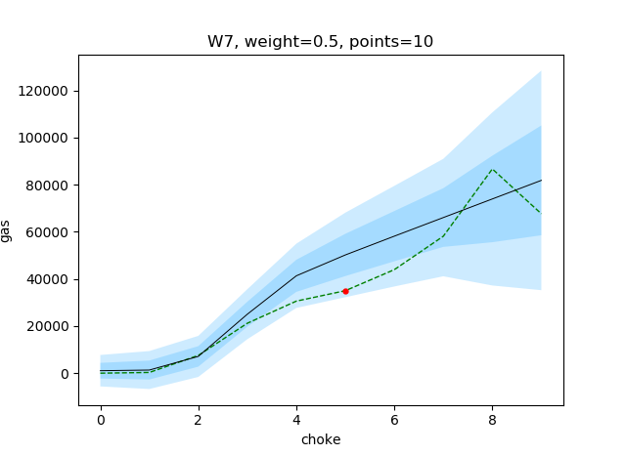

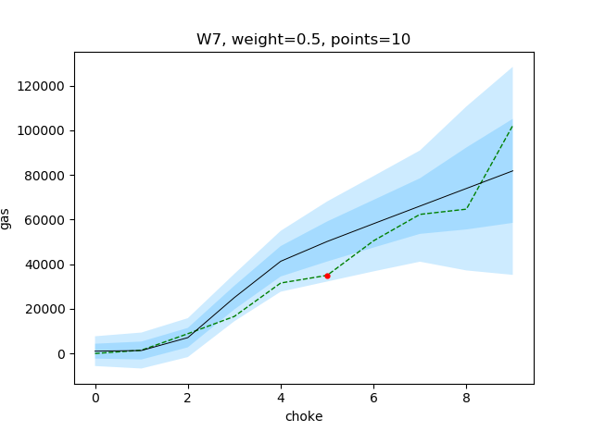
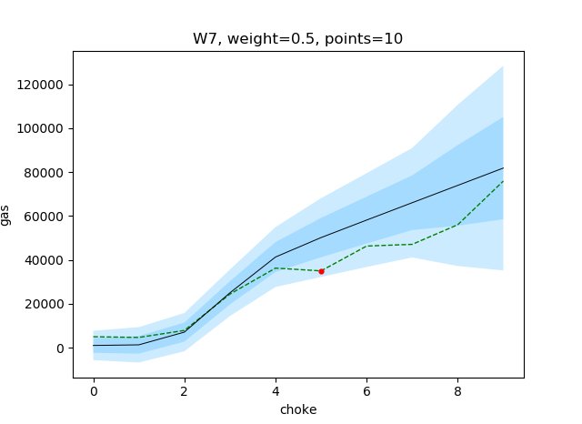
Specifying a Known Point, 4 Examples
(x*, y*) = (50, 35000)
(choke, gas output)

Slide 25
Scenario Generation Model – Discussion Points
It is still necessary to train a new network per scenario, well to apply the new scenario generation procedure. Probably quickly becomes intractable
Alternatively, one may use SOS2. This will however scale very poorly with higher dimensional inputs due to grid approximation issues. For neural networks, adding input dimension is simple and avoids another approximation step
Possible approach: Feasibility study, how does solution time scale with number of scenarios/neural networks needed to represent them?

